Slide 1
Computer Modelling and Simulation
Lecture 3

Slide 2
Types of Modelling Techniques
Physics-based
Data-based
Agent-based

Slide 3
Physics-based Modelling
Solidly grounded in Mathematics.
A physics - based model is a mathematical model where the model equations are derived from basic physical principles.
Example:
The height of a body falling freely under gravity is modelled by
h = v_{i}t+1/2gt²
Predator-Prey relationship is modelled by
ds/dt = k_{s}s – k_{hs}h_{s}
dh/dt = k_{sh}s_{h} – k_{h}h

Slide 4
Data-based (Data-Driven) Modelling
Results from models based on data describing represented aspects of the subject of the model.
Model development begins with data collection, which is used in simulations.
When the physics of the model subject is not understood or computations costs are high, data - based modelling can substitute.
This modeling relies on data availability — it functions at its best when the data are accurate and reliable.
Example:

Slide 5
Data-based (Data-Driven) Modelling
We have data measurements and wish to obtain a function that roughly goes through a plot of the data points capturing the trend of the data, or fitting the data.
Then we can use the function to find estimates at places where data do not exist or to perform further computations.
This function is called Empirical Model.
An empirical model is based only on data and is used to predict, not explain, a system.

Slide 6
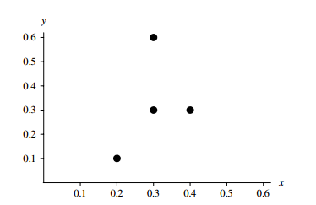
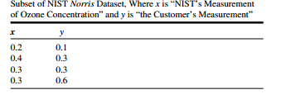
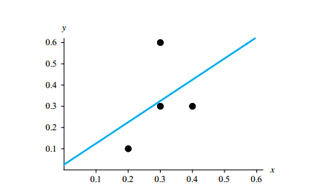
Example of Data-Driven Modelling
Plot of given data
Plot of given data with best-fit line

Slide 7
Agent-based Modelling
ABMs consist of agents.
Agents are defined as “autonomous software entities that interact with their environment or other agents to achieve some goal or accomplish some task. “
An agent’s environment and the existence of other agents in that environment also play a key role on how an agent may behave.
Example: If the Predator-Prey relationship is modeled using Agent-based modelling then the Predator and Prey will be both modelled as agents each with their own set of states which they change based on their interaction with each other and their environment.

Slide 8
Agent-based Modelling
Each agent has a state, which is represented by a set of state variables and behaviors, which control its actions.
A method or procedure, which is associated with a class, or breed or group, of agents, is a function that captures some or all of an agent’s behavior.
A simulation frequently includes several global simulation variables, which all agents can access.

Slide 9
Paradigms of Simulation
Continuous Simulation
Discrete-Event Simulation
Monte Carlo Simulation

Slide 10
Continuous Simulation
The system variables are continuous functions of time .
Time is the independent variable and the system variables evolve as time progresses.
Continuous simulations systems make use of differential equations in developing the model

Slide 11

Continuous Simulation
Example: Consider bacterial population of size 100, an instantaneous growth rate of 10% = 0.10, and time measured in hours. Then, the population growth can be modeled using the following equation:

Slide 12
Discrete-Event Simulation
The system variables are discrete functions in time.
These discrete functions in time result in system variables that change only at distinct instants of time.
The changes are associated with an occurence of a system event.
Discrete - event simulations advance time from one event to the next event.
This simulation paradigm adheres to queuing theory models.

Slide 13
Discrete-Event Simulation
Take the example of traffic light.
State: Its state can be represented by which light is activated at any given time. So State variable called light color is chosen to represent its state.
The value of that variable at any given point in time completely describes the state of the traffic light.
Events for the traffic light system consist of switch to red, switch to yellow , and switch to green .
These events occur in a predetermined sequence and may be triggered by the passage of a certain amount of time. Or they may be triggered by the event of the presence of a vehicle over some roadway sensor or a video system recognizing when a vehicle enters its field of view.

Slide 14
Monte Carlo Simulation
Randomly samples values from each input variable distribution and uses that sample to calculate the model ’ s output.
This process of random sampling is repeated until there is a sense of how the output varies given the random input values.
Monte Carlo simulation models system behavior using probabilities.

Slide 15
Example of Monte Carlo Simulation
Consider you have a coin which you toss four times and you want to find the probability of having 3 heads and 1 tail.
Using combinatorics, we’ll find the probability in the following way
P(3 heads and 1 tail) = 4/16 = 1/4
There are 4 possibilities that tail would occur exactly once so remaining three times heads would occur and the total number of possible combinations of heads and tails in 4 tosses would be 2⁴=16.
But not in every situation you can use the concept of combinatorics to find the probability of an event.

Slide 16
Example of Monte Carlo Simulation
The probability of 3 heads and 1 tail in 4 tosses of the coin can be found by the Monte Carlo simulation in the following way:
Toss the coin 4 times and see if the desired outcome (3 heads and 1 tail) has occurred or not.
Tossing 4 coins once constitute one experiment.
Repeat this experiment a larger number of times.
Count the number of times the desired outcome has occurred.
Divide the count in the above step by total number of experiments.
The result will be the probability of getting three heads and 1 tail in 4 tosses of coin using Monte Carlo simulation.

